Slide 1

Comparative Analysis of Acetylcholinesterase (AChE) Using Biopython: Conserved Motifs and Phylogenetic Insights
Muskan Kashyap (MSc Biotechnology)

Slide 2


What is this project about?
A bioinformatics analysis of the enzyme Acetylcholinesterase (AChE).
Used Biopython to study AChE sequences from different species.
Identified conserved motifs (functionally important regions).
Constructed a phylogenetic tree to understand evolutionary relationships.
Why AChE?
AChE plays a critical role in nerve signal transmission.
Inhibiting AChE is a key strategy in Alzheimer’s disease drug design.
Understanding conserved regions can help in drug target identification.

Slide 3
Objectives :
To collect acetylcholinesterase (AChE) protein sequences from multiple species.
To perform multiple sequence alignment (MSA) using Biopython.
To identify conserved motifs/regions important for enzyme function.
To construct a phylogenetic tree and explore evolutionary relationships.
To demonstrate how Biopython can be used for real-world bioinformatics research.
Database → FASTA sequences → Alignment → Conserved motifs → Phylogenetic tree

Slide 4
Background: Acetylcholinesterase (AChE) and Alzheimer’s Disease
Acetylcholinesterase (AChE): -Key enzyme that breaks down the neurotransmitter acetylcholine at nerve synapses. -Essential for proper nerve signal transmission.
Relevance to Alzheimer’s disease (AD): -In AD, acetylcholine levels drop, impairing memory and cognition. -AChE inhibitors are widely used as drugs (e.g., Donepezil, Rivastigmine). -Conserved regions in AChE may serve as drug target sites.
Why compare sequences across species? -Conserved motifs → indicate functionally important regions. -Phylogenetic analysis → reveals evolutionary relationships.

Slide 5
Tools & Technologies :
FASTA Sequences → Biopython → Alignment (Clustal) → Tree (Matplotlib)
Programming Language: Python
Libraries & Frameworks: Biopython → Sequence handling, alignment, phylogenetic tree construction Matplotlib → Tree visualization
Alignment Tool: Clustal Omega (via Biopython wrapper) → Multiple sequence alignment (MSA)
Data Source: Protein sequences retrieved in FASTA format (from UniProt/NCBI)

Slide 6

Methodology: Step-by-Step Process

Slide 7
Step 1: Sequence Collection
Collected Acetylcholinesterase (AChE) protein sequences from multiple species (Human, Mouse, Rat, Zebrafish, Fruit fly).
Downloaded sequences in FASTA format from UniProt/NCBI databases.
FASTA format = simple text file containing sequence name + amino acid sequence.

Slide 8
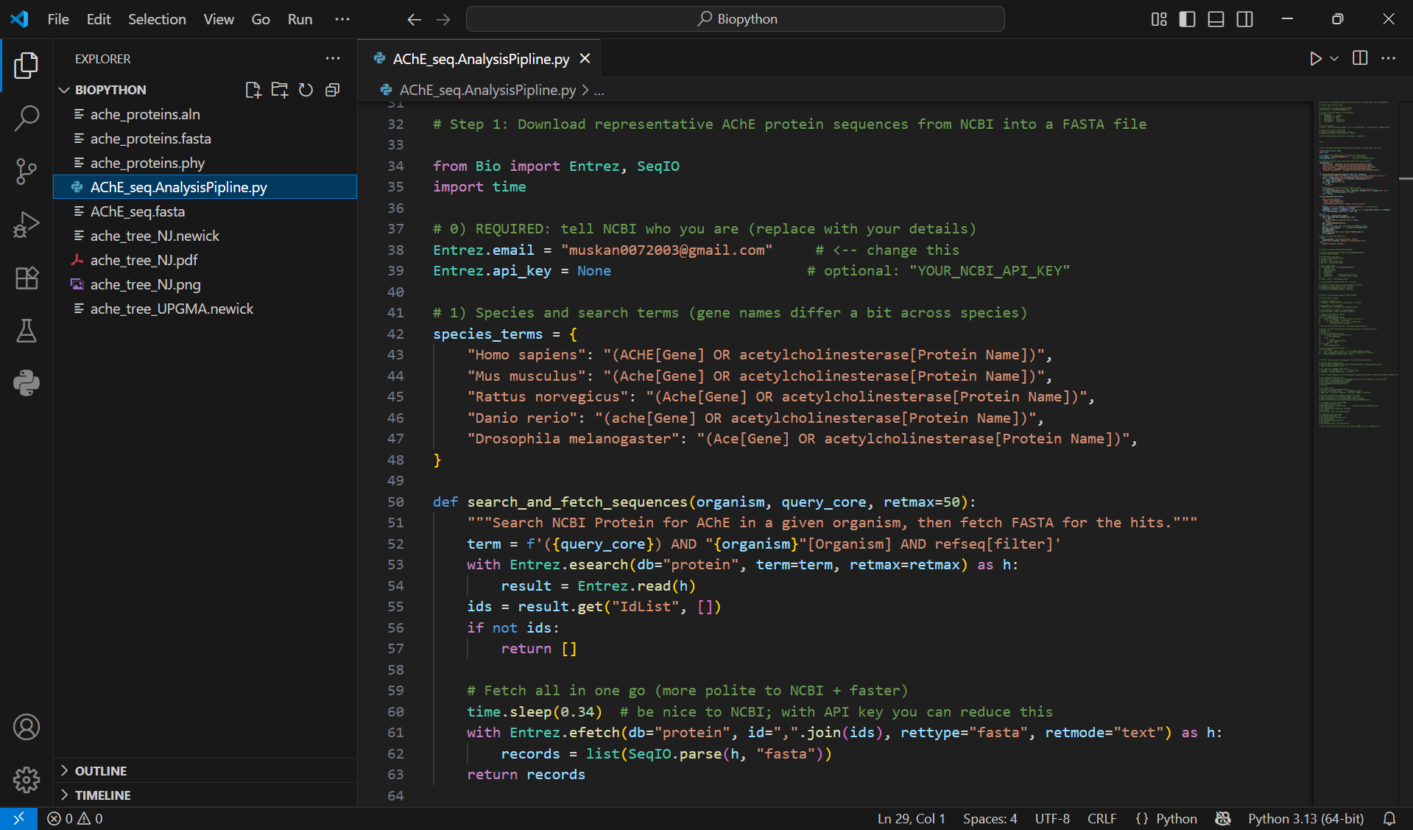

Slide 9
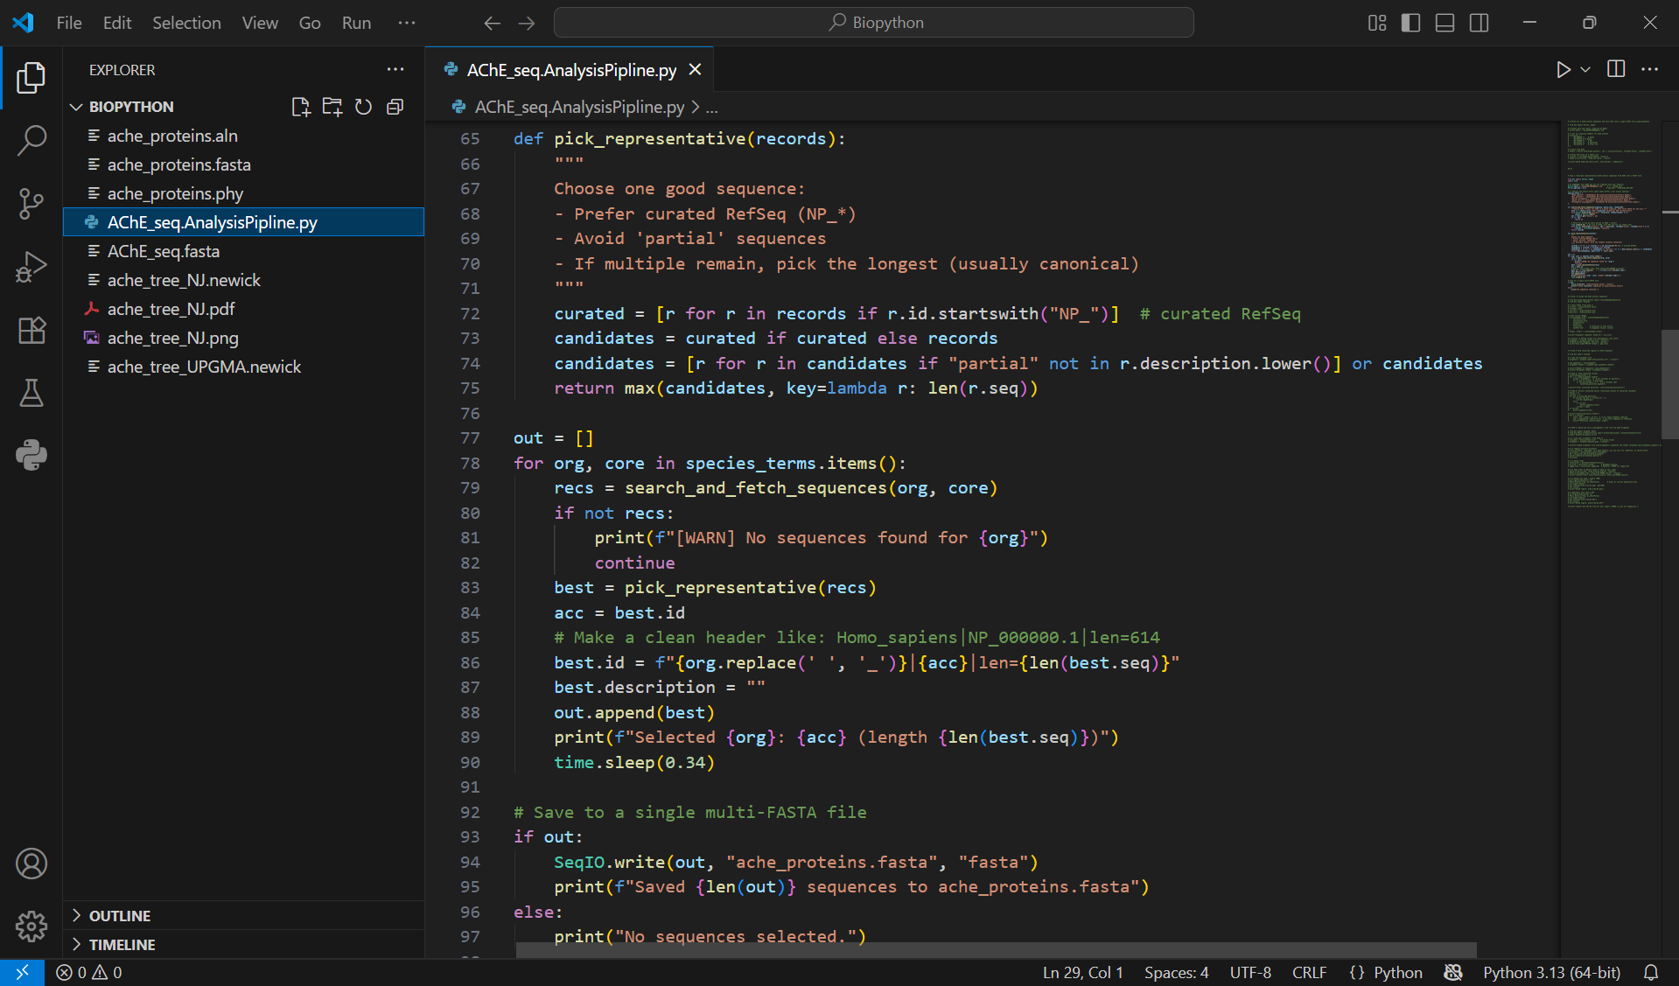

Slide 10
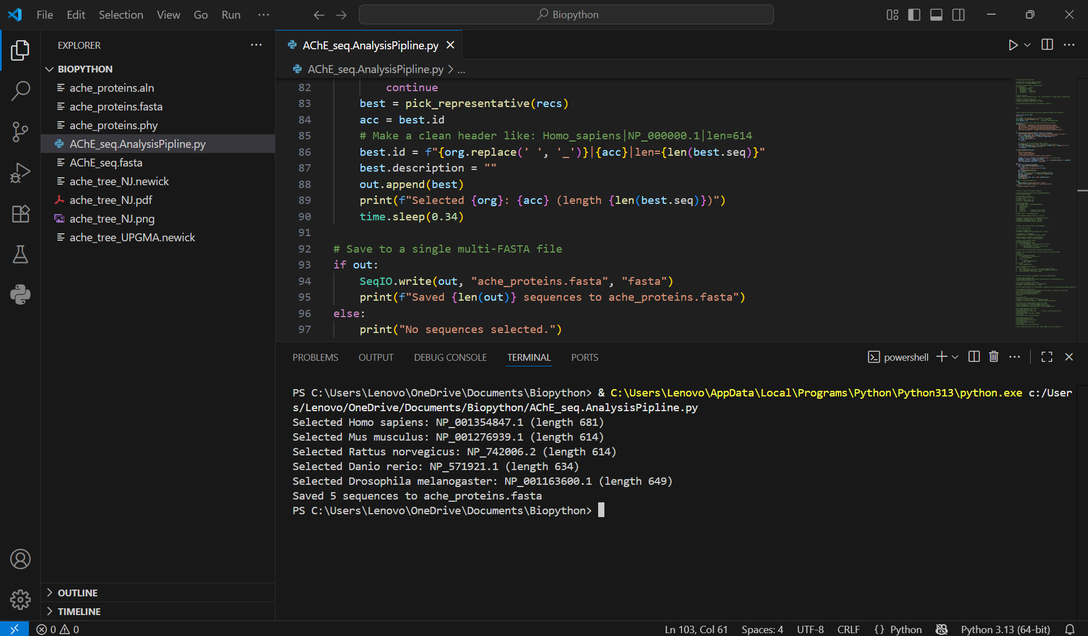

Slide 11
Step 2: Multiple Sequence Alignment (MSA)
Used Clustal Omega (through Biopython) to align sequences.
MSA arranges sequences in a way that similar regions are aligned vertically.
Purpose: To identify conserved motifs that remain unchanged across species (indicating functional importance).
Output files generated: .aln → alignment file (can be opened in Jalview/Clustal viewer). .phy → PHYLIP format (used in phylogenetic tree construction).

Slide 12
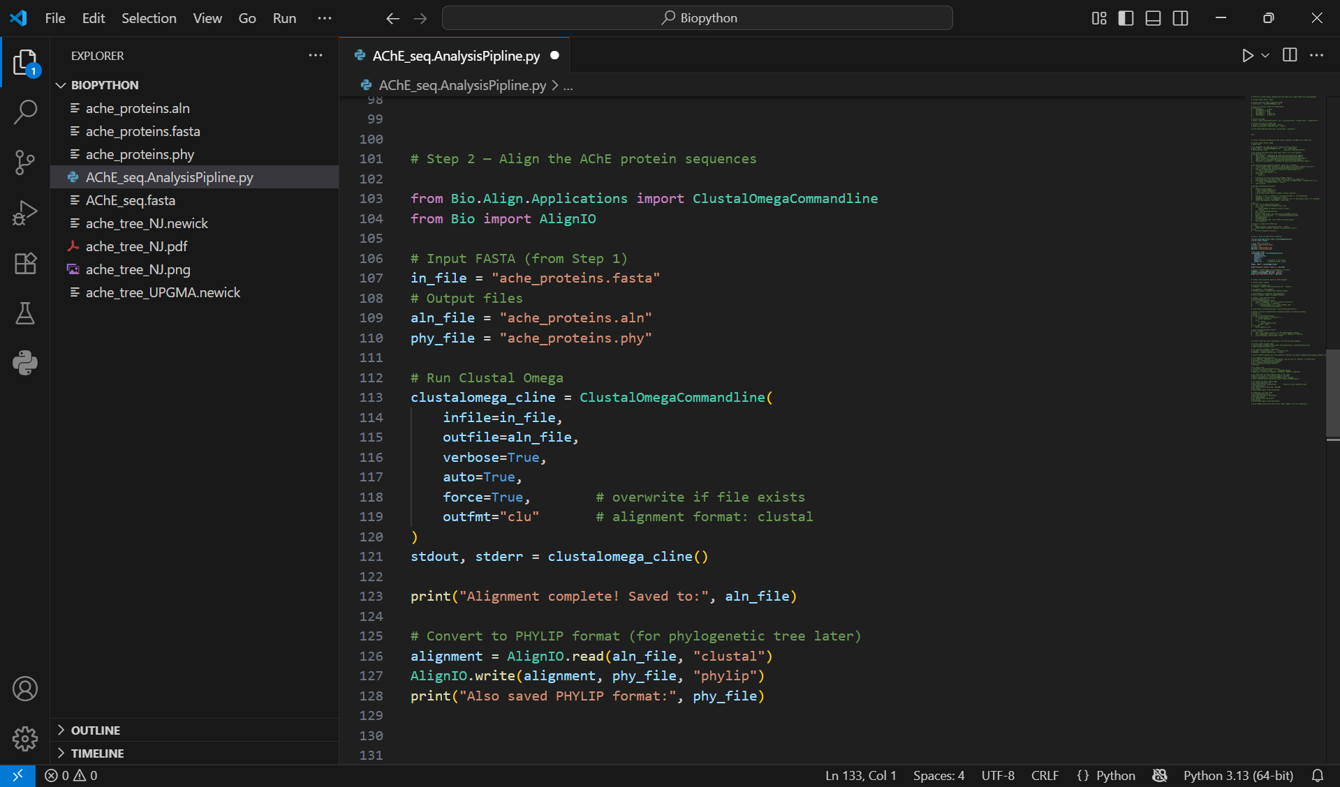

Slide 13
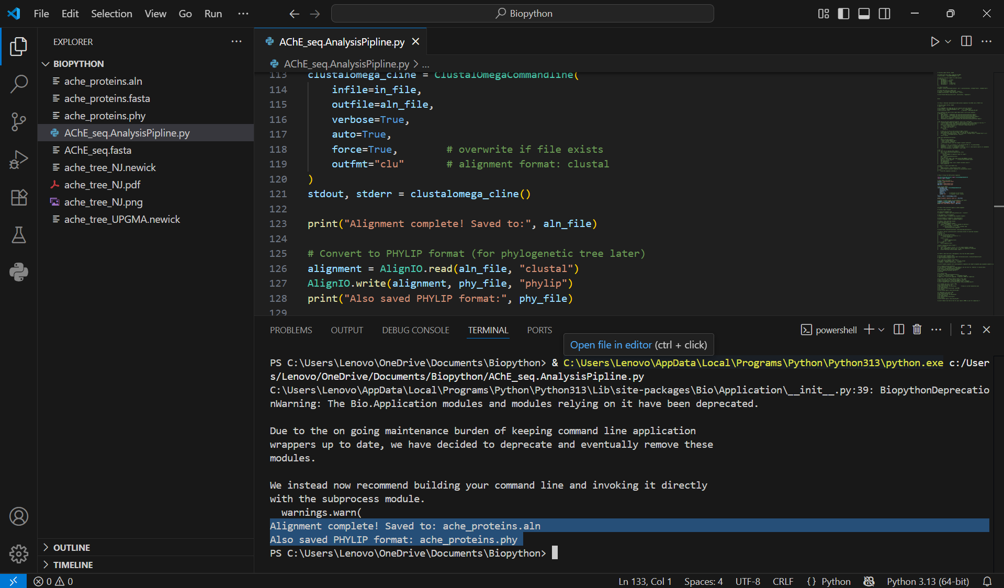

Slide 14
Step 3: Conserved Motif Identification
Analyzed the aligned sequences to find blocks of amino acids conserved across species.
These conserved motifs likely represent active sites or binding regions of AChE.
Such regions are important in drug design (because drugs bind to conserved functional sites).

Slide 15
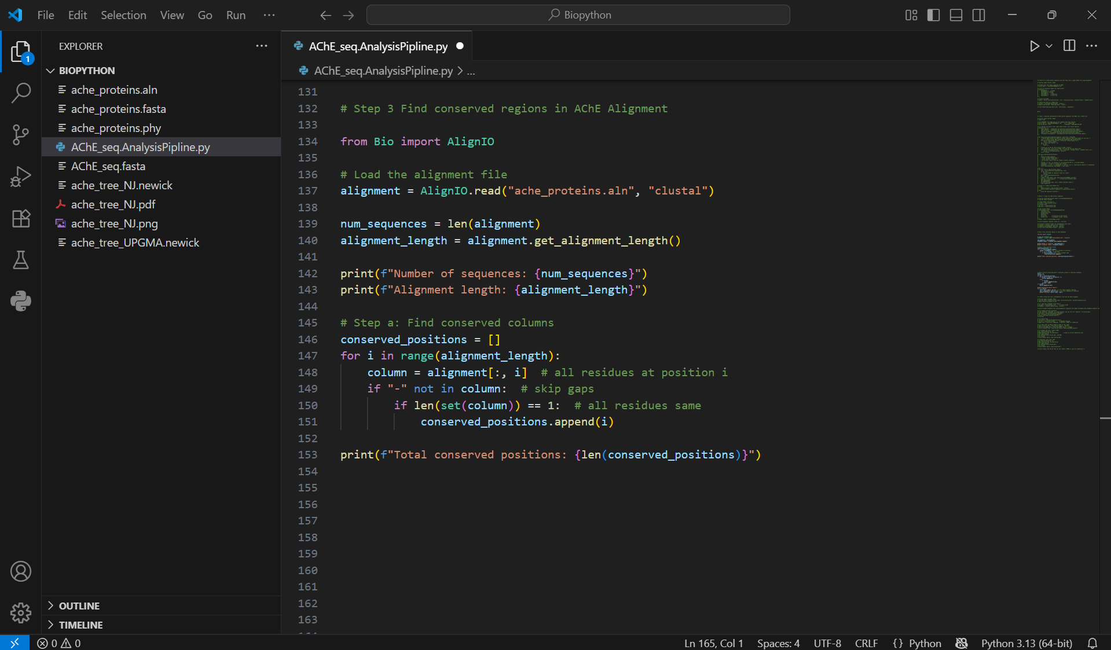

Slide 16
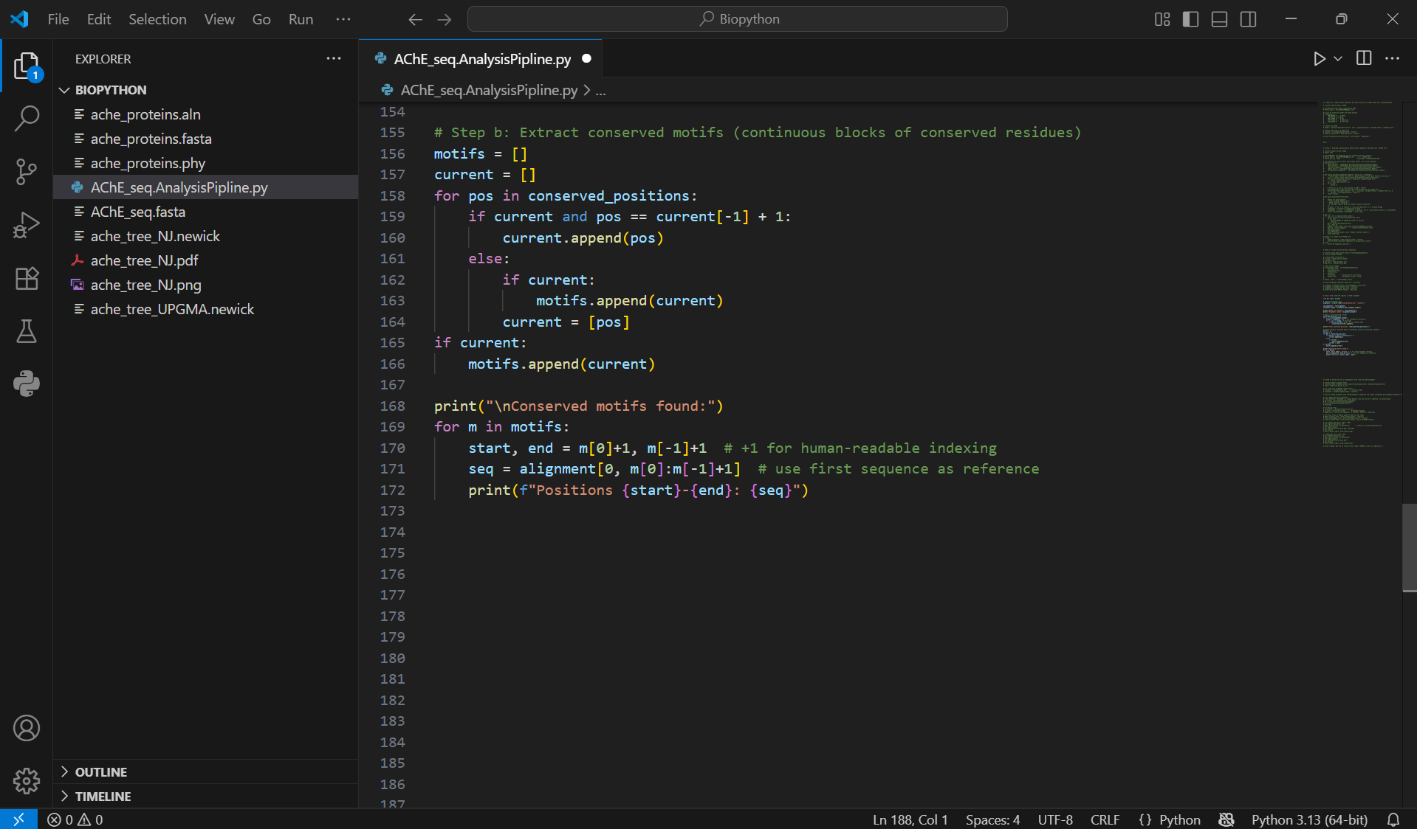

Slide 17
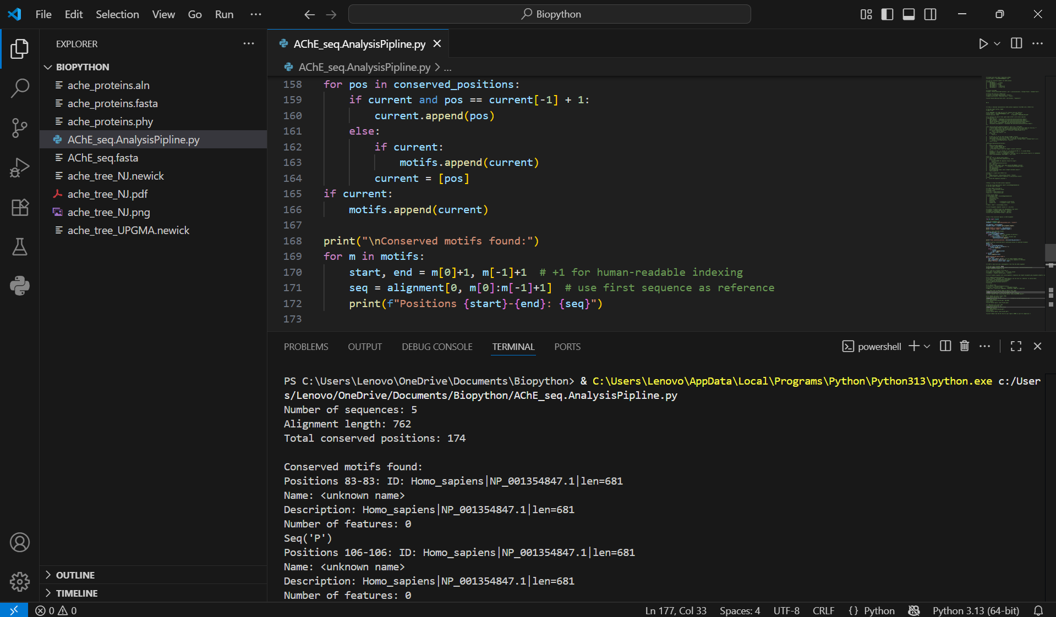

Slide 18
Step 4: Phylogenetic Tree Construction
Used Biopython’s Phylo module to construct a tree from the alignment.
The tree shows evolutionary relationships among species based on AChE similarity.
Example: Human AChE is closer to Mouse/Rat than to Zebrafish or Fruit fly.
Exported and visualized tree as .png for presentation.

Slide 19
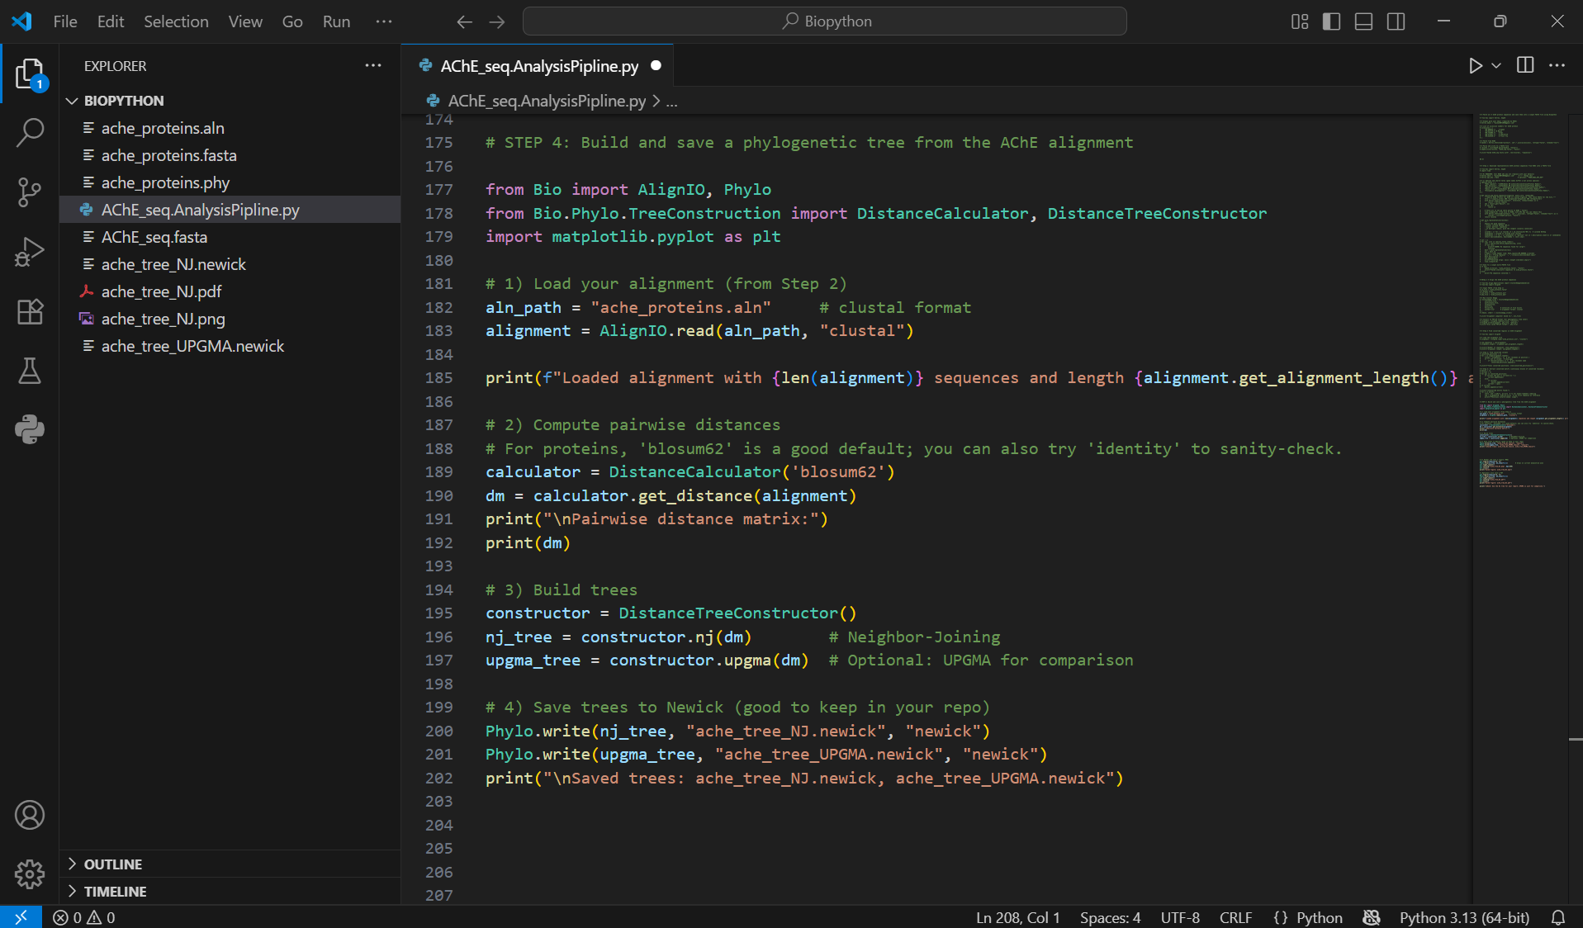

Slide 20
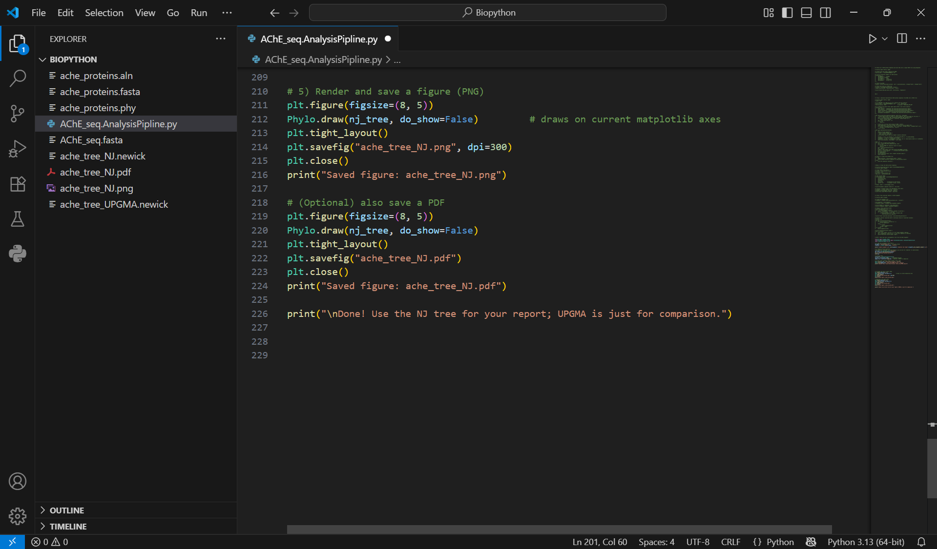

Slide 21
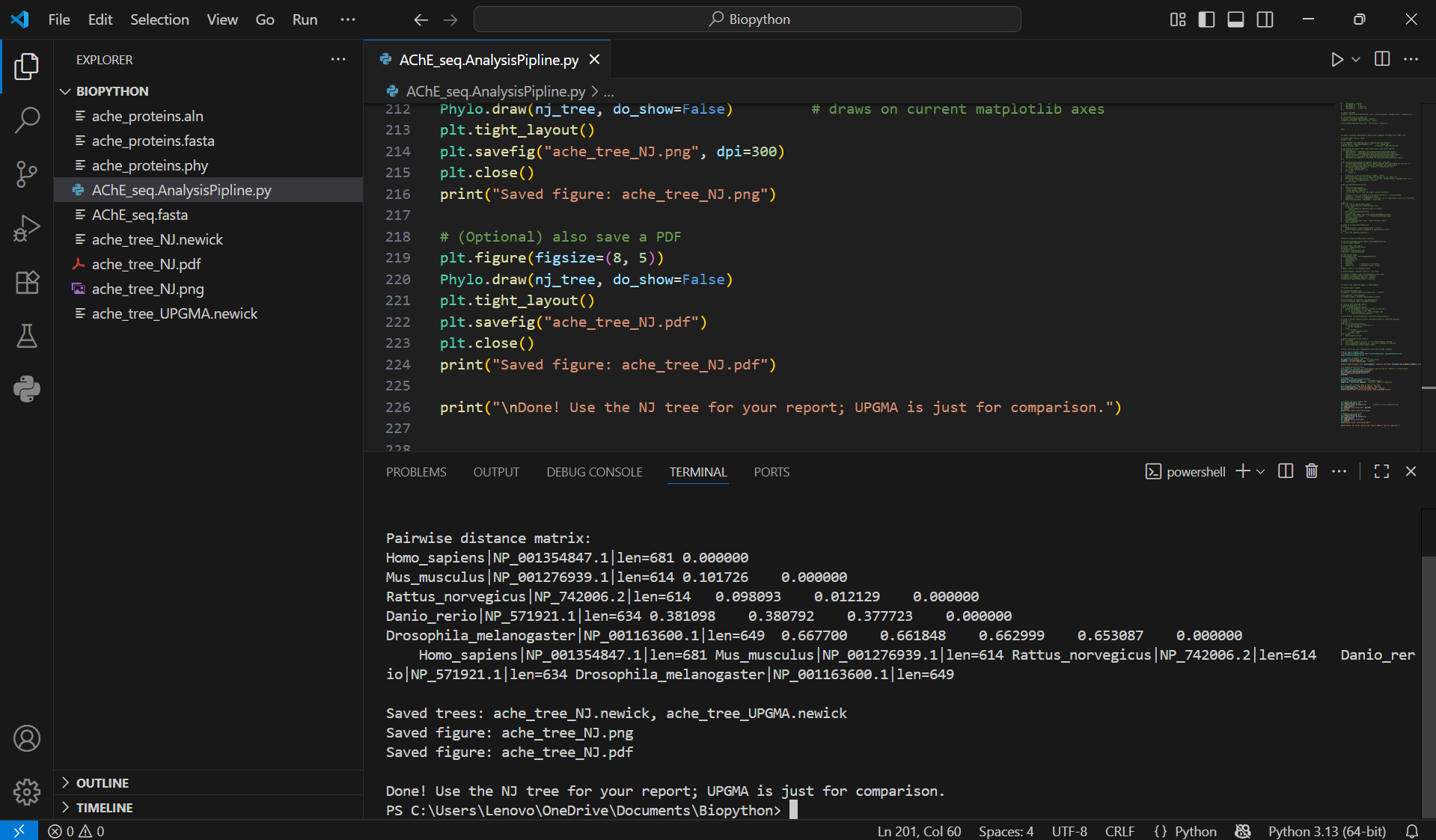

Slide 22
Visualization & Interpretation

Slide 23
Results – Multiple Sequence Alignment (MSA) & Conserved Motifs
Alignment Process Performed using Clustal Omega via Biopython. Input: ache_proteins.fasta (AChE sequences from human, mouse, rat, zebrafish, fruit fly).
Output files: .aln file → for alignment visualization. .phy file → for tree construction.
Key Observations Fully conserved motifs detected → identical residues across all species. Semi-conserved regions → substitutions with chemically similar amino acids. Variable regions → species-specific differences. Conserved motifs suggest functional importance (likely active or binding sites).

Slide 24
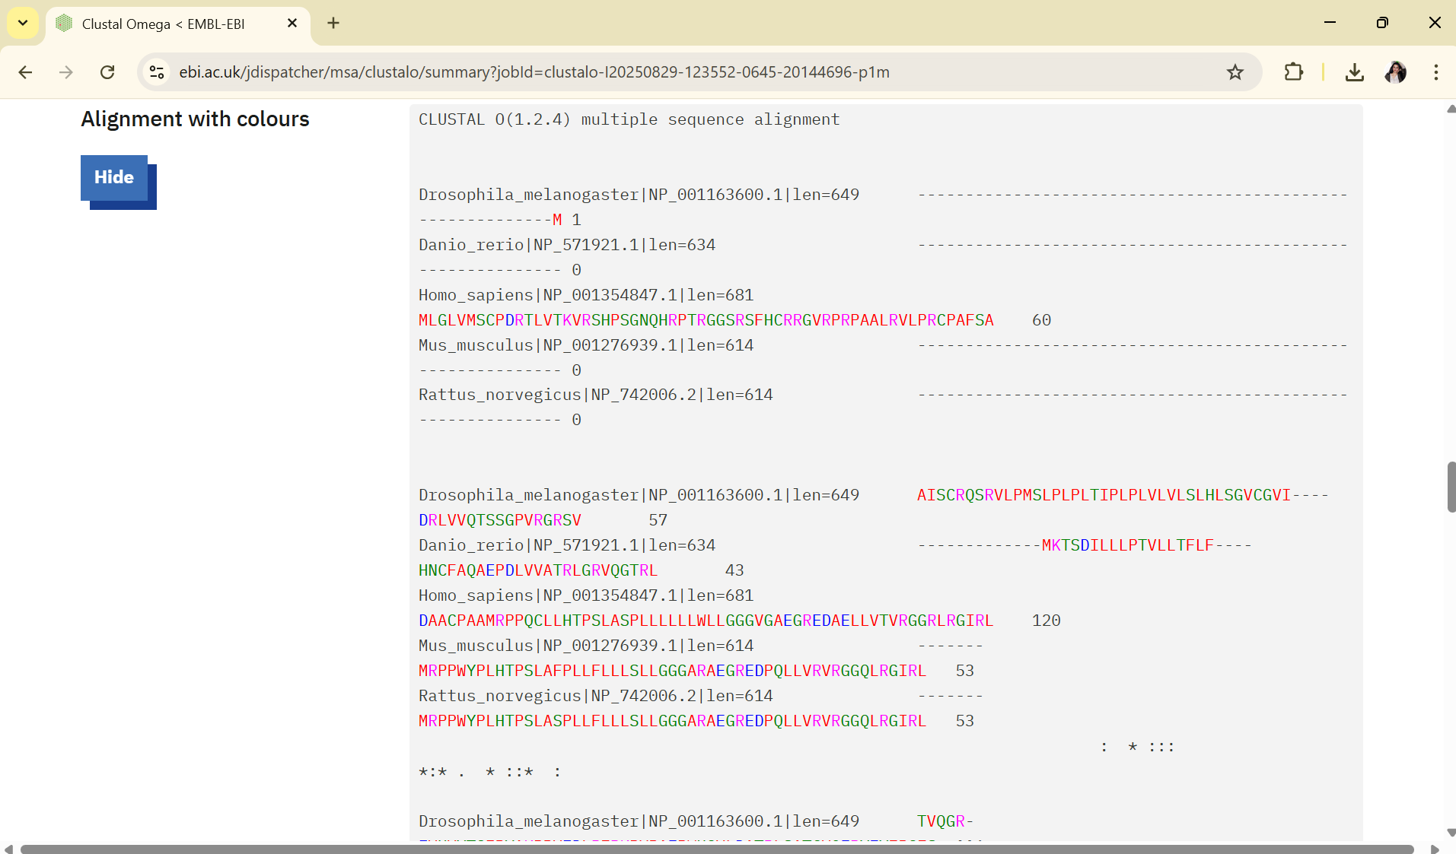
Alignment viewed in Clustal Omega online viewer

Slide 25
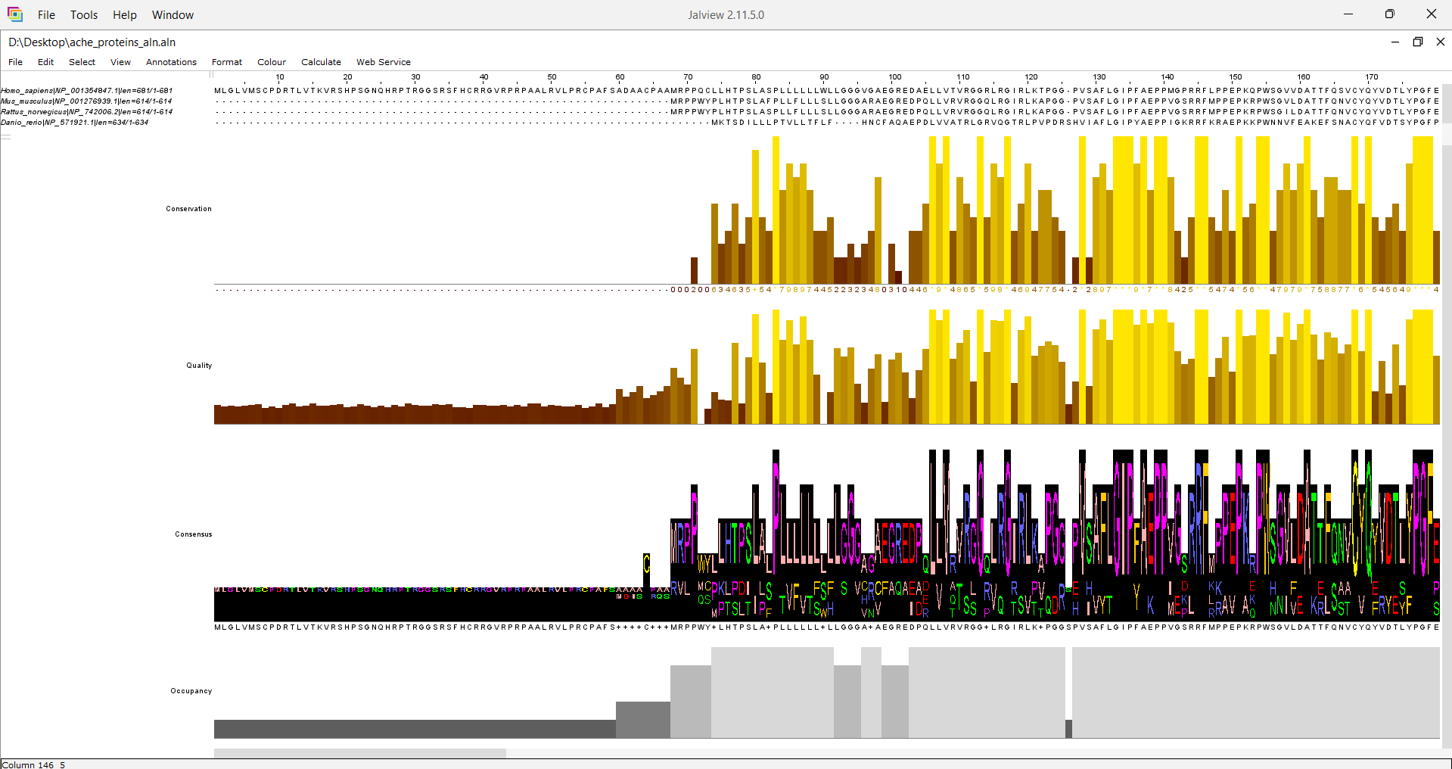
Alignment viewed in Jalview

Slide 26
Results – Phylogenetic Tree (Biopython + Matplotlib)
Tree Construction Used Biopython (Phylo module) with the .phy alignment file. Tree visualization performed using Matplotlib. Exported tree as an image (tree.png).
Key Observations -Human AChE clustered closely with mouse and rat, reflecting mammalian evolutionary relationship.
-Zebrafish formed a separate branch → closer to mammals than insects but still distinct.
-Fruit fly (insect) appeared as the most distant branch, confirming evolutionary divergence.

Slide 27
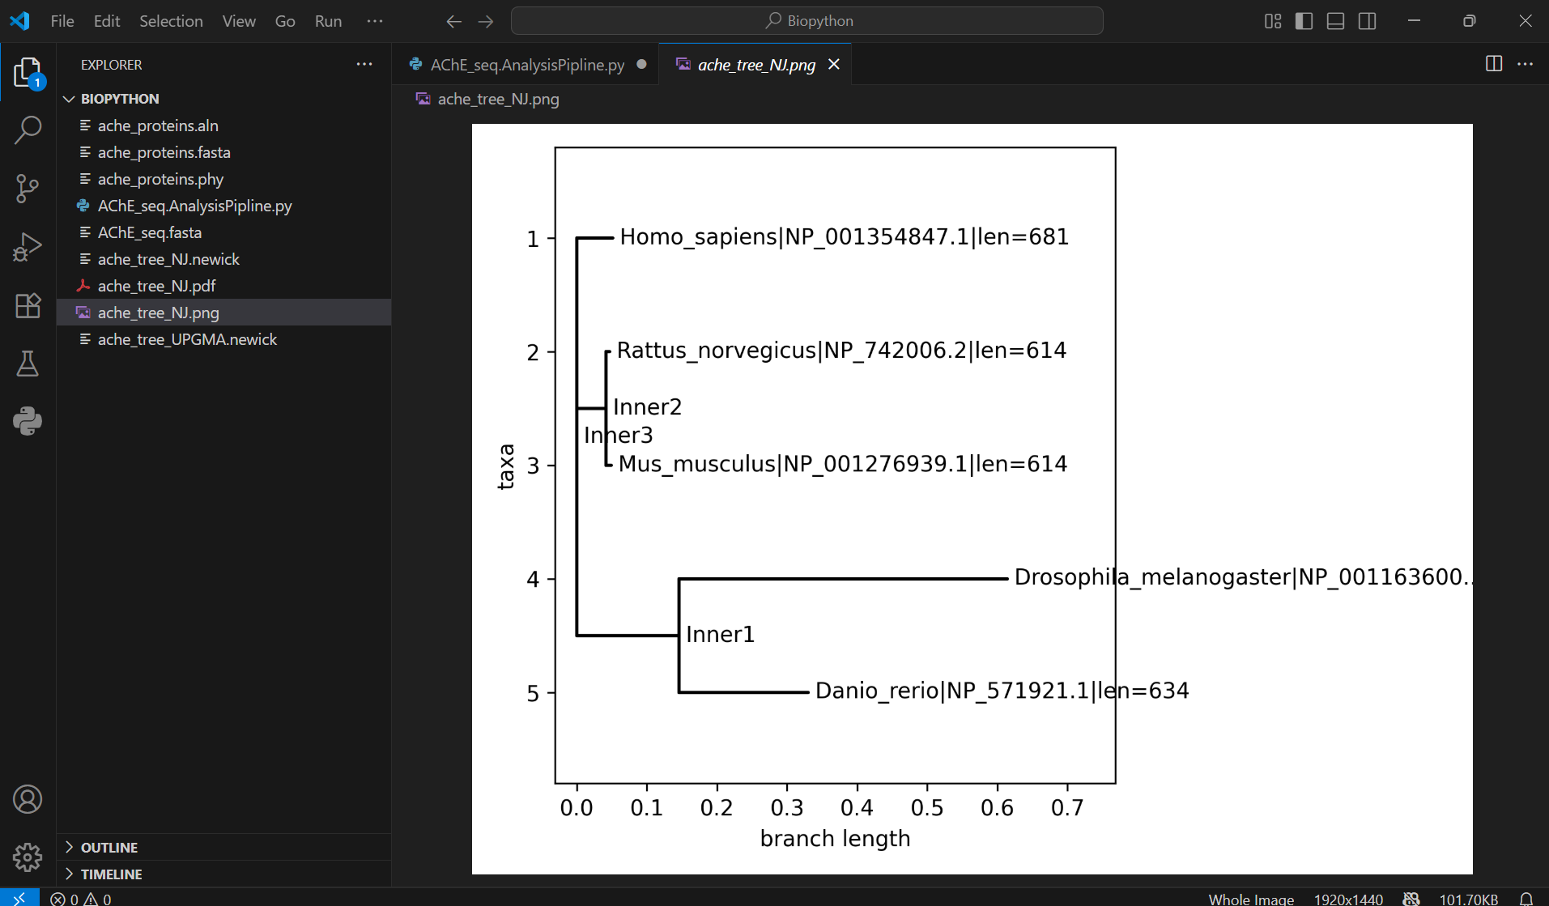
Phylogenetic tree visualized with Matplotlib + Biopython

Slide 28
Discussion & Biological Significance :
Key Findings
Multiple Sequence Alignment (MSA): -Conserved motifs identified across all 5 species. -Suggest these residues are functionally essential (active/binding sites).
Phylogenetic Tree: -Mammals (human, mouse, rat) grouped together. -Zebrafish formed a separate branch but still closer to mammals than insects. -Fruit fly diverged earliest, showing largest evolutionary distance.
Biological Significance
Conserved motifs → potential drug target regions for Alzheimer’s therapies. Mammalian clustering → validates mouse/rat as suitable models for AChE research. Evolutionary insights → highlights structural conservation of AChE across species.

Slide 29
Conclusion :
Successfully analyzed Acetylcholinesterase (AChE) sequences from multiple species using Biopython.
Multiple Sequence Alignment (MSA): revealed conserved motifs, indicating essential functional regions.
Phylogenetic Tree: showed evolutionary relationships — mammals grouped closely, insect (fruit fly) most distant.
Demonstrated how bioinformatics tools (Biopython, Jalview, Matplotlib) can provide insights into protein conservation and evolution.

Slide 30
Future Work :
Expand dataset → include more species for broader evolutionary analysis.
Structural modeling → map conserved motifs onto 3D AChE protein structure.
Drug docking studies → test interactions of conserved sites with potential inhibitors (e.g., curcumin, donepezil).
Automated pipeline → build a Biopython script to handle retrieval, alignment, tree building, and visualization in one go.

Slide 31
Future Work :
Expand dataset → include more species for broader evolutionary analysis.
Structural modeling → map conserved motifs onto 3D AChE protein structure.
Drug docking studies → test interactions of conserved sites with potential inhibitors (e.g., curcumin, donepezil).
Automated pipeline → build a Biopython script to handle retrieval, alignment, tree building, and visualization in one go.

Slide 32

Acknowledgements
Biopython developers for providing open-source bioinformatics tools.
Clustal Omega & Jalview for multiple sequence alignment visualization.
Matplotlib for phylogenetic tree plotting.
NCBI for sequence data retrieval.
This Photo by Unknown Author is licensed under CC BY-SA

Slide 33
References
Cock PJA et al. (2009). Biopython: freely available Python tools for computational molecular biology and bioinformatics. Bioinformatics, 25(11):1422–1423.
Sievers F & Higgins DG. (2018). Clustal Omega for making accurate alignments of many protein sequences. Protein Science, 27(1):135–145.
Waterhouse AM et al. (2009). Jalview Version 2—a multiple sequence alignment editor and analysis workbench. Bioinformatics, 25(9):1189–1191.
Hunter JD. (2007). Matplotlib: A 2D graphics environment. Computing in Science & Engineering, 9(3):90–95.
This Photo by Unknown Author is licensed under CC BY-SA

Slide 34
Thank You!

